Slide 1
ParkNow
Kalaivani S

Slide 2
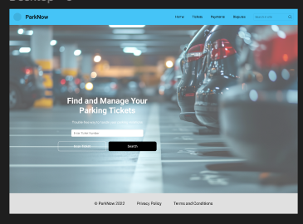
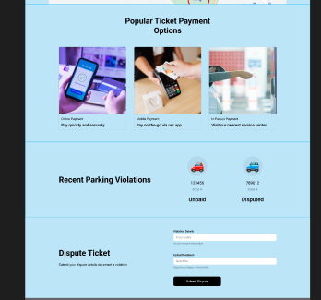
Project overview
The product:
ParkNow is a mobile app and responsive website designed to help users find, dispute, and manage their parking tickets easily. The target users include regular drivers who face parking violations and need a hassle-free way to resolve issues.
Project duration:
November, 2024 - December, 2024

Slide 3
Project overview
The problem:
Users often struggle with managing their parking tickets due to complicated processes and lack of information.
The goal:
To create a user-friendly platform that simplifies the process of finding, disputing, and paying for parking tickets.

Slide 4
Project overview
My role:
UX designer
Responsibilities:
User research
Wireframing
Prototyping
Usability testing

Slide 5
User research
Personas
Problem statements
User journey maps
Understanding
the user

Slide 6
User research: Summary
Conducted interviews and surveys to understand user pain points related to parking violations. Initial assumptions about user frustration were validated through direct feedback.

Slide 7
User research: pain points
1
2
3
4
Difficulty in finding ticket information
Complicated payment processes
Lack of clear dispute processes.
Confusion over violation statuses.
This guided the design of a centralized ticket management feature.
Led to the development of streamlined payment options.
Resulted in creating an intuitive dispute submission workflow.
Influenced the design of a clear status indicator system.

Slide 8
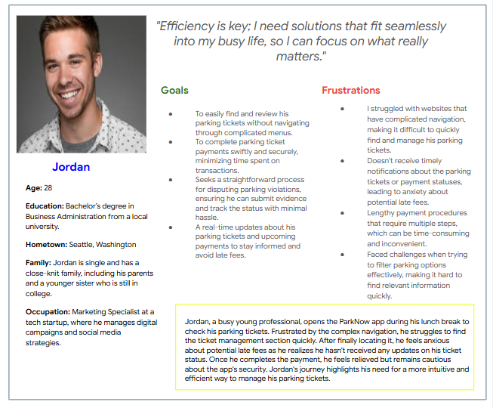
Persona: Jordan
Problem statement:
Jordan is a busy young professional who needs intuitive website navigation and effective search filters in the ParkNow app because he wants to manage parking tickets and payments quickly and stress-free while on the go.

Slide 9
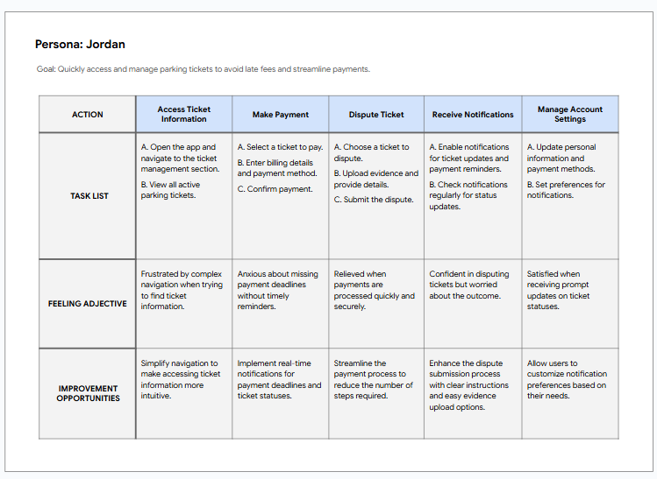
User journey map
I created a user journey map of Jordan’s experience using the site to help identify possible pain points and improvement opportunities.

Slide 10
Sitemap
Paper wireframes
Digital wireframes
Low-fidelity prototype
Usability studies
Starting
the design

Slide 11
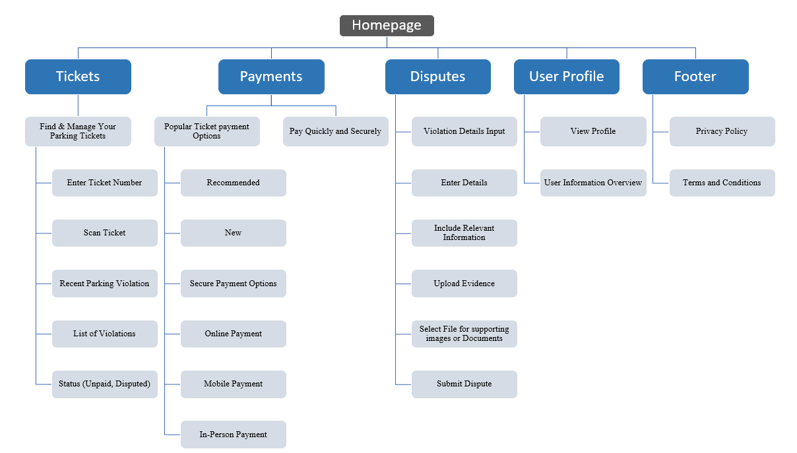
Sitemap
The ParkNow sitemap is designed to provide a clear and intuitive navigation structure for users looking to manage their parking tickets effectively. It includes essential sections such as Tickets, where users can find and dispute their violations, and Payments, which offers various payment options for convenience. The Disputes section allows users to easily contest tickets by submitting relevant evidence. Additionally, the User Profile section personalizes the experience, while the footer provides access to important information like privacy policies. This sitemap ensures that users can effortlessly navigate the app to resolve their parking issues.

Slide 12
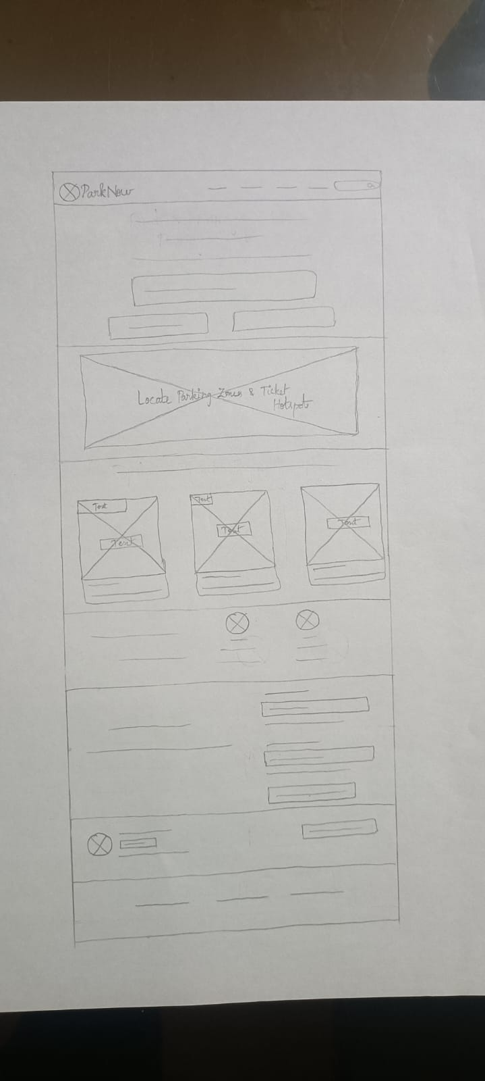
Paper wireframes
The paper wireframe for the ParkNow app consists of five different screen variations focusing on the Ticket Management Page, aimed at enhancing user interaction and clarity. Each version explores various layouts for displaying active tickets, including ticket details, payment options, and dispute functionalities. The primary goal was to identify the most intuitive design that facilitates quick access to essential features while minimizing user frustration. Feedback from peers led to refining the wireframes by simplifying navigation and emphasizing critical actions, resulting in a more user-friendly final design.

Slide 13
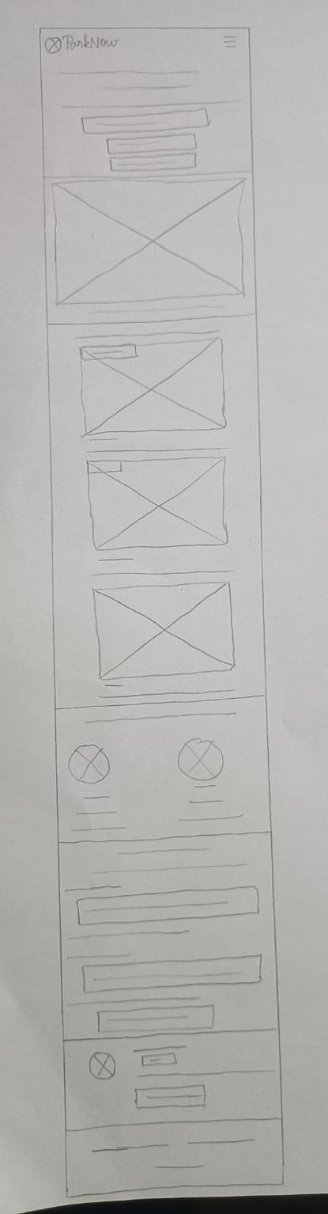
Paper wireframe
screen size variation(s)
Because ParkNow Users access the site on a variety of different devices, I started to work on designs for additional screen sizes to make sure the site would be fully responsive.

Slide 14
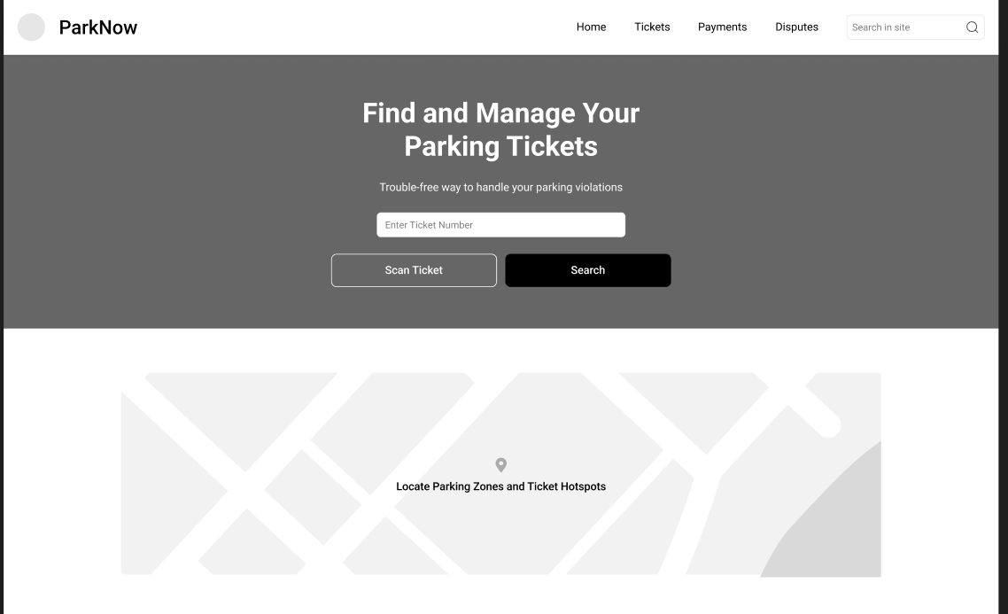
Digital wireframes
Moving from paper to digital wireframes made it easy to understand how the redesign could help address user pain points and improve the user experience.
Prioritizing useful button locations and visual element placement on the home page was a key part of my strategy.
Map Showing the parking zones and Ticket Hotspots.

Slide 15
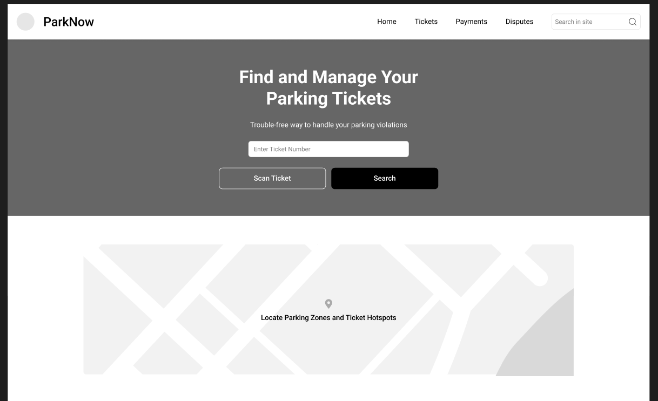
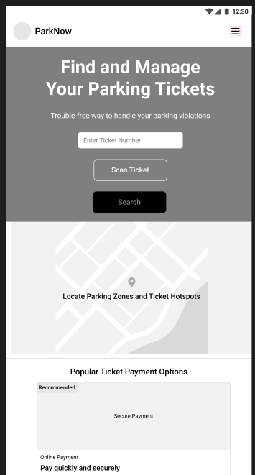
Digital wireframe
screen size variation(s)

Slide 16
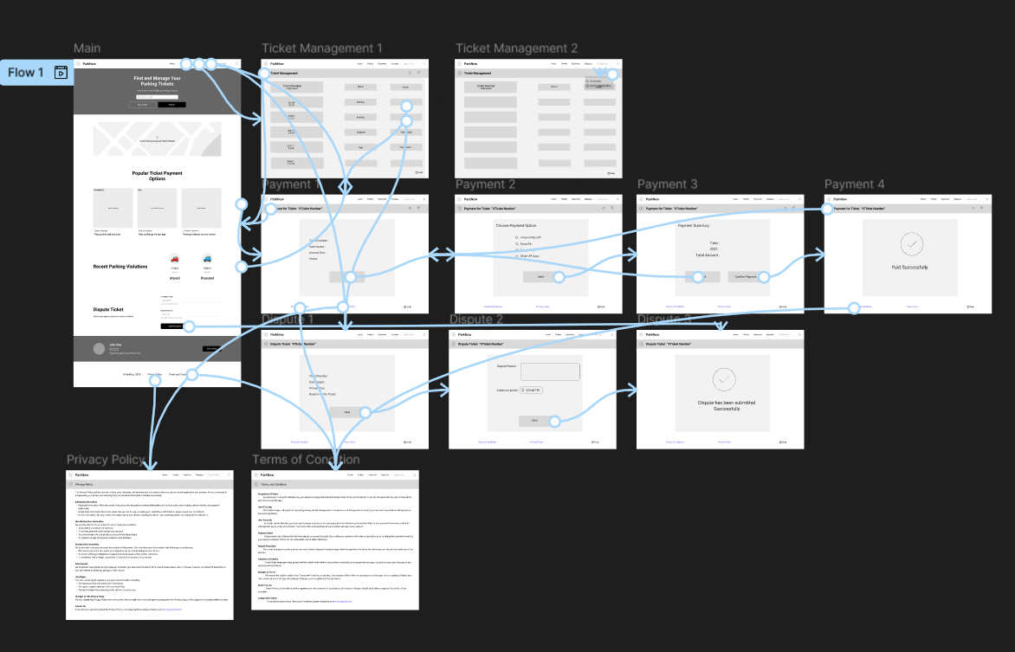
Low-fidelity prototype
In the ParkNow app, I developed several low-fidelity prototypes to explore different screen variations and enhance the user experience. The prototypes included key screens such as the Ticket Management Page, Payment Page, and Dispute Submission Page. Each prototype aimed to streamline user interactions based on feedback gathered from initial user research.
The user flow begins with the Home Page, where users can navigate to manage their parking tickets. From there, they can access the Ticket Management Page to view active tickets and select one for payment or dispute. Upon clicking "Pay Now," users are directed to the Payment Page, where they can enter their payment details. If they choose to dispute a ticket, they are taken to the Dispute Submission Page to provide necessary information and evidence.
View ParkNow low- fidelity prototype

Slide 17
Usability study: parameters
Study type:
Unmoderated usability study
Location:
United States, remote
Participants:
5 participants
Length:
20-30 minutes

Slide 18
Usability study: findings
The usability studies conducted for the ParkNow app provided valuable insights into user interactions and areas for improvement. Below are three key findings from the studies:
1
2
3
Navigation Confusion
Payment Process Clarity
Dispute Submission Complexity
Users struggled to locate key features, indicating that the navigation structure needed simplification to enhance accessibility and user flow.
Participants expressed uncertainty during the payment process, suggesting that clearer labeling and step-by-step guidance would improve user confidence and reduce errors.
Users found the dispute submission form overwhelming, highlighting the need for a more streamlined approach with fewer fields and clearer instructions to facilitate easier submissions

Slide 19
Refining
the design
Mockups
High-fidelity prototype
Accessibility

Slide 20
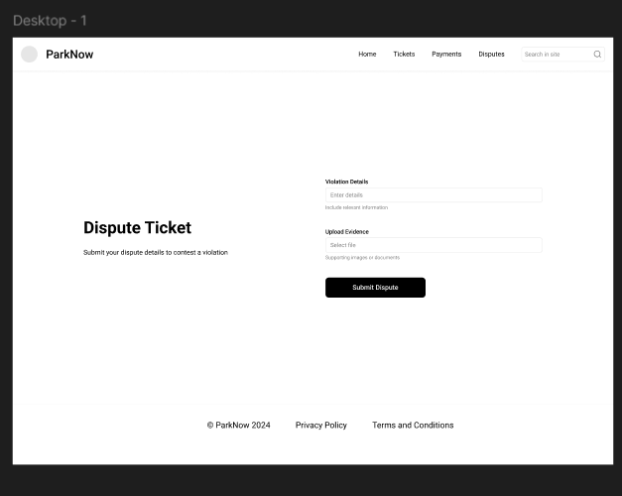
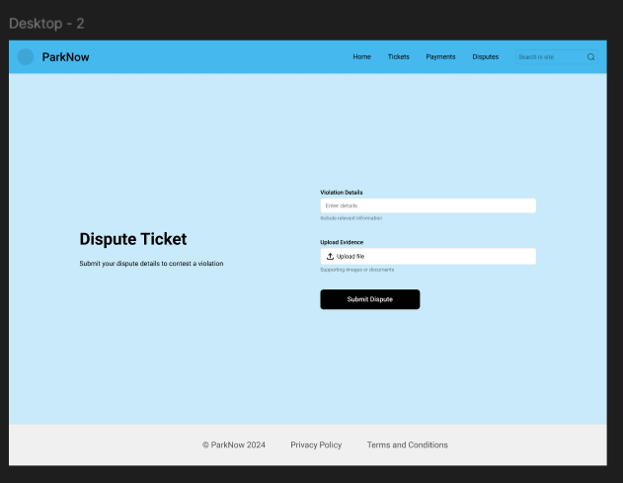
Mockups
Based on the insights from the usability study, I made changes to improve the disputes evidence submit. One of the changes I made was adding the upload button to access device images or documents . This allow users to dispute violations directly through the app by submitting evidence, such as photos or documents, along with a clear explanation of their case.
Before usability study
After usability study

Slide 21
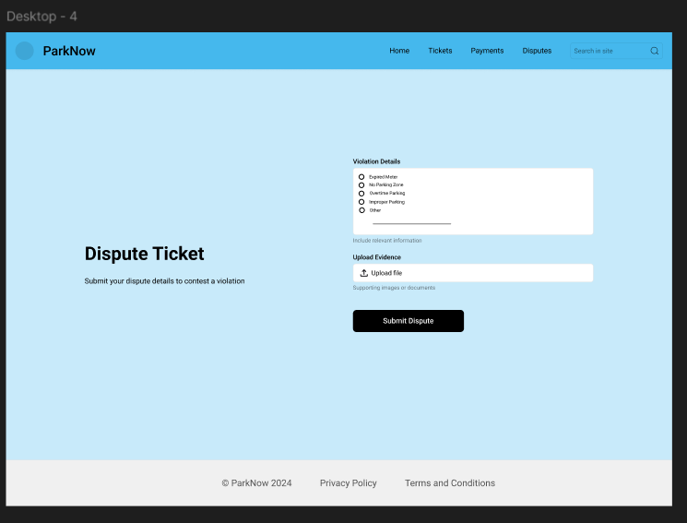
Mockups
Based on the insights from the usability study, I made changes to improve the chances of selecting dispute reason. One of the changes I made was adding the option radio to select the dispute options . This allow users to choose dispute violations directly through the app by clicking the options , along with a clear explanation of their case.
Before usability study
After usability study
Mockup 2 before

Slide 22
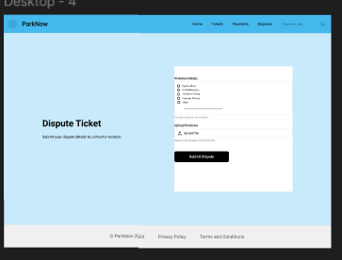
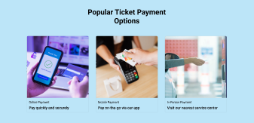
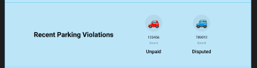
Mockups: Original screen size

Slide 23
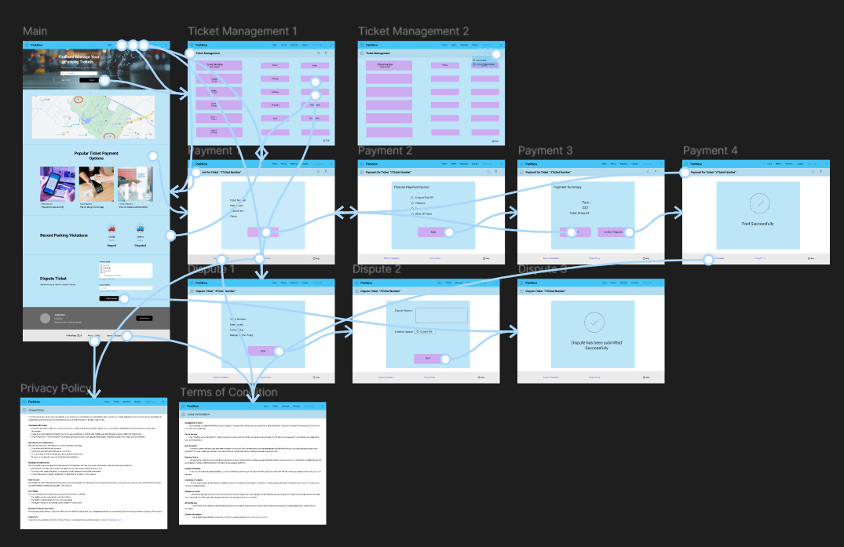
High-fidelity prototype
[Links to low-fidelity prototypes of different screen variants and brief description of the user flow + how you responded to and implemented peer feedback]

Slide 24
Accessibility considerations
1
2
3
I ensured that text and background colors meet WCAG guidelines for contrast, making it easier for users with visual impairments to read and navigate the app without straining their eyes.
The app was designed to be fully navigable using a keyboard, allowing users with mobility impairments to access all features without relying on a mouse, thereby enhancing overall usability.
All images and icons in the app include descriptive alt text, ensuring that users who rely on screen readers can understand the content and functionality of visual elements effectively.

Slide 25
Going forward
Takeaways
Next steps

Slide 26
Takeaways
Impact:
Insert one to two sentences summarizing the impact of your designs. In the real world, you’d include data like number of downloads or sign ups, but since this is a course project, you can include a positive quote from a peer or study participant.
What I learned:
Throughout the ParkNow app project, I gained valuable insights into the UX design process, including the importance of user research in identifying pain points and informing design decisions. I learned how to effectively create wireframes and prototypes to visualize ideas and test usability. I discovered the significance of incorporating peer feedback to refine designs and enhance user experience.

Slide 27
Next steps
1
2
3
Conducting further usability testing to gather more user feedback on the latest design iterations, ensuring that all features meet user needs effectively.
I plan to implement a beta testing phase with a select group of users to identify any remaining issues before the official launch.
I will focus on developing a marketing strategy to promote the app and increase user adoption, leveraging insights gained from user research to tailor messaging that resonates with our target audience.

Slide 28
Let’s connect!
Let’s connect! I would like to hear from you and discuss my work further. You can reach me at kvani11021@gmail.com to review more of my projects.

